Slide 1
Special Education Training: Staff & Parents
In-service August 2024 by Nikole Cheskey

Slide 2
Welcome Back!
Topics to cover today
Federal Laws: Individuals with Disabilities Act of 2004 –Child Find, Section 504 of the Rehabilitation Act & The Elementary and Secondary Education Act (ESEA) reauthorized as Every Student Succeeds Act (ESSA).
Identify South Dakota Disability categories
Define Individual Education Plans (IEPs) and membership roles for IEP meetings
Questions and Answers

Slide 3
Individual with Disabilities Education Act (IDEA) and Section 504
Federal Laws that help protect the rights of students with disabilities.

Slide 4
300.111 Child Find
(1) The State must have in effect policies and procedures to ensure that—
(i) All children with disabilities residing in the State, including children with disabilities who are homeless children or are wards of the State, and children with disabilities attending private schools, regardless of the severity of their disability, and who are in need of special education and related services, are identified, located, and evaluated; and
(ii) A practical method is developed and implemented to determine which children are currently receiving needed special education and related services.
(b) Use of term developmental delay. The following provisions apply with respect to implementing the child find requirements of this section:
(1) A State that adopts a definition of developmental delay under §300.8(b) determines whether the term applies to children aged three through nine, or to a subset of that age range (e.g., ages three through five).
(2) A State may not require an LEA to adopt and use the term developmental delay for any children within its jurisdiction.
(3) If an LEA uses the term developmental delay for children described in §300.8(b), the LEA must conform to both the State’s definition of that term and to the age range that has been adopted by the State.
(4) If a State does not adopt the term developmental delay, an LEA may not independently use that term as a basis for establishing a child’s eligibility under this part.
(c) Other children in child find. Child find also must include—
(1) Children who are suspected of being a child with a disability under §300.8 and in need of special education, even though they are advancing from grade to grade; and
(2) Highly mobile children, including migrant children.
(d) Construction. Nothing in the Act requires that children be classified by their disability so long as each child who has a disability that is listed in §300.8 and who, by reason of that disability, needs special education and related services is regarded as a child with a disability under Part B of the Act.
US Department of Education online https://sites.ed.gov/idea/regs/b/b/300.111

Slide 5
At a glance – Child Find is part of the federal Individuals with Disabilities Education Act. The purpose of the law is to serve the education needs of kids with disabilities
Schools have a big responsibility—they must identify, locate, and evaluate any kids who need special education. This is called “Child Find.” Looking for and finding these kids is an important first step toward getting them the help they need to thrive in school.
When a school knows, or thinks a child could have a disability, it must evaluate the child. Child Find applies to kids from birth to age 21. It can cover kids with learning and thinking differences, developmental delays, and other conditions.

Slide 6
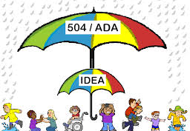
IDEA: All students eligible under IDEA are also eligible for Section 504
504: Not all students who are eligible for section 504 are also eligible for IDEA
Channing Bete Company Understanding IDEA and Section 504 A guide for parents of children with disabilities. 2022 Edition

Slide 7
IDEA and Section 504
IDEA provides federal guidelines and funding to states (BIE) to help guarantee special education and related services to eligible students ages 3 to 21. (under 3 may be eligible for early intervention services)
Parental consent required
Requires and Individual Education Plan (IEP) outlining services that may help a student benefit from special education
Federal funds provided to schools to help serve eligible children
Channing Bete Company Understanding IDEA and Section 504 A guide for parents of children with disabilities. 2022 Edition
504 prohibits discrimination against any person with a disability by any federally funded agency or organization. It requires states to provide programs for eligible students with disabilities that are equal to those for students without disabilities. There is no age requirement for 504.
Parental consent recommended
Requires a plan describing placement and services. Services for ALL students be equal.
No funds provided

Slide 8
Who can get services under these laws?
IDEA covers students who need special education and related services because they have a disability in one or more these categories
Bold category is the majority of disabilities identified at the PILC
The Disability categories can be found at
https://doe.sd.gov/sped/IEP.aspx
in the Referral/Eligibility table.
500-Deaf Blindness
505-Emotional Disability
510-Cognitive Disability
515-Hearing Loss
525-Specific Learning Disability
535-Orthopedic Impairment
540-Vision Loss
545-Deafness
550-Speech/Language Impairment
555-Other Health Impaired
560-Austim Spectrum Disorder
565-Tramatic Brain Injury
570-Developmental Delay

Slide 9
Section 504 covers any person who:
Has a physical or mental impairment that limits one or more major life activity
Has a record of such impairment (doctor’s diagnosis)
Is regarded as having such an impairment
Channing Bete Company Understanding IDEA and Section 504 A guide for parents of children with disabilities. 2022 Edition
A major life activity under 504 includes:
Breathing
caring for oneself
Concentrating
Eating
Hearing
Learning
Performing manual tasks
Seeing, speaking, walking and working

Slide 10


IDEA & Section 504 aim to help students with disabilities reach their potential.
They can improve opportunities for higher education, future employment and achieving independence in adulthood.
They involve parent/guardians in their education. Teamwork is an important part of a successful plan

Slide 11
If you or a parent or guardian think a child is eligible please reach out to the school.
-A potential evaluation of child’s history including medical records will be conducted
-Observations from professionals, yourselves, teachers and anyone who works with the child could be done
-Possible referral for special tests to measure the child’s development, abilities, intelligence, behavior and academic progress will potentially be completed

Slide 12


.
Feed
Key Learning Disability Statistics:
At least 1 in every 59 children has one or several learning disabilities. 1 in 5 children in the U.S. have learning and thinking differences such as ADHD or Dyslexia. As of 2021, 2.8 million kids are actively getting services involving special education.
41 Learning Disabilities Statistics & Prevalence (2023)
https://www.crossrivertherapy.com › learning-disabilities...
In 2022–23, the number of students ages 3–21 who received special education and/or related services under the Individuals with Disabilities Education Act (IDEA) was 7.5 million, or the equivalent of 15 percent of all public school students. Among students receiving special education and/or related services, the most common category of disability was specific learning disabilities (32 percent).
https://nces.ed.gov/programs/coe/indicator/cgg/students-with-disabilities
At the conclusion of SY2034-24 the PILC had a 40% special education rate.

Slide 13
Some of the main principles under IDEA:
A FREE, APPROPRIATE PUBLIC EDUCATION (FAPE)- Eligible students receive special education & related services at no cost to parents. These services must meet state standards.
EVALUATION & PLACEMENT PROCEDURES- A parent’s consent is generally required before an evaluation or placement can take place. A reevaluation takes place at least every 3 years, unless the parents or local education agency agree to postpone it.
LEAST RESTRICTIVE ENVIRONMENT (LRE) FOR LEARNING- As much as possible, eligible students may attend classes in regular classrooms and take part in school activities with children who do not have disabilities.
PROCEDURAL SAFEGUARDS- Schools must give written notice to parents/guardians before initiating or changing (or refusing to change) a student’s *Identification *Evaluation *Educational Placement (such as to receive regular or special education).
Channing Bete Company Understanding IDEA and Section 504 A guide for parents of children with disabilities. 2022 Edition

Slide 14
Section 504 shares many of the same principles of IDEA, with only a few differences
FAPE- As with IDEA, eligible students have the right under Section 504 to an education that is equal to that provided to students without disabilities. Special Education and Related services to meet this requirement are provided at no cost to parents.
EVALUATION AND PLACEMENT PROCEDURE- An evaluation is required before placement changes or accommodations can be made. Periodic reevaluation is required, but the frequency is not specified. As with IDEA, parental consent is required before the initial evaluation
THE LEAST RESTRICTIVE ENVIRONMENT- (LRE) Same policy as IDEA
PROCEDURAL SAFEGUARDS- Parents must be told about any identification, evaluation and/or placement before any significant changes are made
REASONABLE ACCOMMODATIONS- Students must receive opportunities that are comparable to those provided to children w/out disabilities. This includes academic and non-academic school programs.
Channing Bete Company Understanding IDEA and Section 504 A guide for parents of children with disabilities. 2022 Edition

Slide 15
Elementary and Secondary Education Act (ESEA):
The Elementary and Secondary Education Act (ESEA) was signed into law in 1965 by President Lyndon Baines Johnson, who believed that "full educational opportunity" should be "our first national goal." From its inception, ESEA was a civil rights law.
ESEA offered new grants to districts serving low-income students, federal grants for textbooks and library books, funding for special education centers, and scholarships for low-income college students. Additionally, the law provided federal grants to state educational agencies to improve the quality of elementary and secondary education.

Slide 16
Every Student Succeeds Act (ESSA) reauthorization of ESEA
President Obama signs the Every Student Succeeds Act into law on December 10, 2015. ESSA includes provisions that will help to ensure success for students and schools.
The law:
Advances equity by upholding critical protections for America's disadvantaged and high-need students.
Requires—for the first time—that all students in America be taught to high academic standards that will prepare them to succeed in college and careers.
Ensures that vital information is provided to educators, families, students, and communities through annual statewide assessments that measure students' progress toward those high standards.
Helps to support and grow local innovations—including evidence-based and place-based interventions developed by local leaders and educators—consistent with our Investing in Innovation and Promise Neighborhoods
Sustains and expands this administration's historic investments in increasing access to high-quality preschool.
Maintains an expectation that there will be accountability and action to effect positive change in our lowest-performing schools, where groups of students are not making progress, and where graduation rates are low over extended periods of time.
US Department of Education online https://www.ed.gov/essa?src=rn

Slide 17
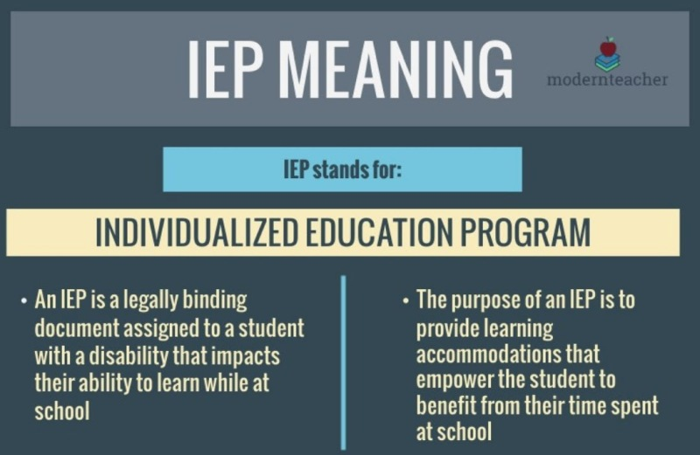
IEP must haves:
-Present Levels of performance
-Measurable annual goals
-How goals will be measured
-Statement of special education and related services
-No later than 16, IEP must address post secondary goals
-All members must be present at IEP meeting
-If agreement to amend or modify the IEP, it can be done w/o a formal meeting
IEP meetings, mediation & resolution meetings can be done via conference call.
Rodriguez and Murawski, 2022

Slide 18
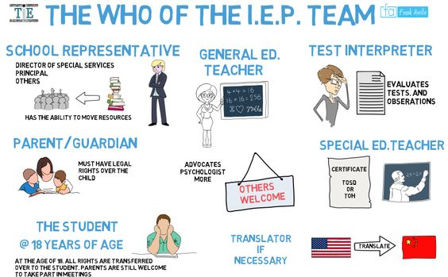
Team members can play more than one role

Slide 19

Trainings Available to PILC staff and parents
Vector Solutions Exceptional Child platform https://pierreilc-sd.exceptionalchild.com/login must check k12 email- Trainings are sent to your email. If you do not have a k12 email let your supervisor know
Direct STEP: https://dc-bie2020-ds.lrp.com/login/index.php3 (create new account)
Special Education Connection: www.specialedconnection.com
(Username: bieedu Password: educate)

Slide 20
Resources:
Channing Bete. Your Guide to Special Education & Your Child. 2016 Edition
Channing Bete. Understanding IDEA and Section 504. A guide for parents of children with disabilities. 2022 Edition.
Disabilities Rights Education & Defense Fund, DREDF. Accessed 2023, May 22. <https://dredf.org>
LD Online. Accessed 2022, June 14. <https://ldoline.org>
Rodriguez , J. A., & Murawski, W. W. (2022). Special Education Law and Policy: From Foundation to Application. San Diego, California: Plural Publishing.
South Dakota Department of Education – Eligibility Guide. (Revised AUGUST 2016). Accessed 2023, May 22 <https://doe.sd.gov>
National Center for Educational Statistics, August 2023 https://nces.ed.gov/programs/coe/indicator/cgg/students-with-disabilities
Understood Accessed 2024, August 6 https://www.understood.org/en/articles/child-find-what-it-is-and-how-it-works
Thank you for your time! Any questions?
Nikole Cheskey- 224-8661 X166
nikole.cheskey@k12.sd.us

